Slide 1
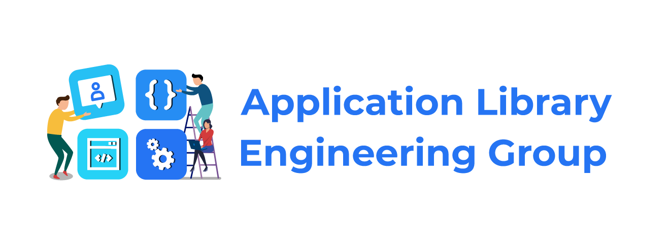
Dialogs & Notifications in Harmony

Slide 2
Today’s Session is about
Dialogs & Notifications - Overview
Types of Dialogs
Notifications
Types of Notifications
Notification Slot

Slide 3
Dialogs
Small window that prompts the user to make a decision or enter additional information.
Package : ohos.agp.window.dialog
BaseDialog : Base class for all dialogs
Notifications
A notification is a message that is displayed outside your app's UI to provide the user with reminders, communication from other people, or other timely information from your app. Users can tap the notification to open your app or take an action directly from the notification.
Package : ohos.event.notification

Slide 4
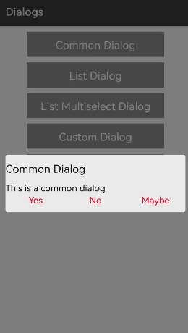
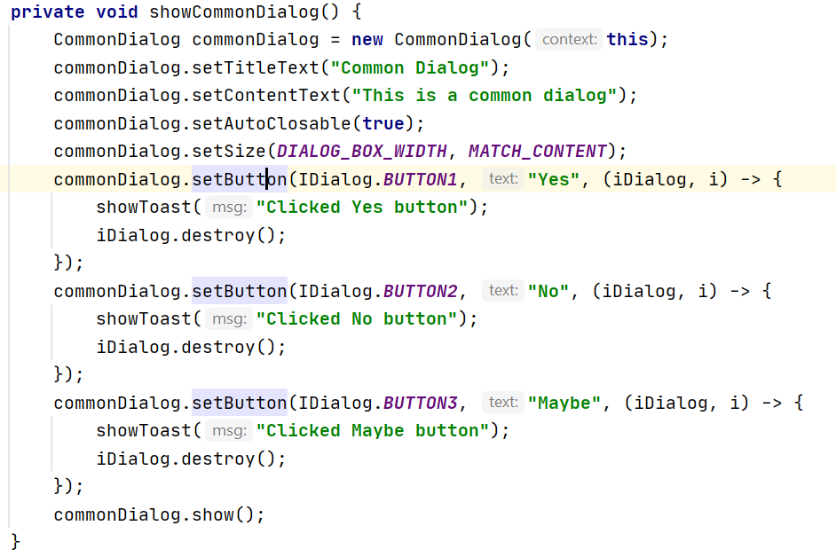
Common Dialog
Creates a common dialog box

Slide 5
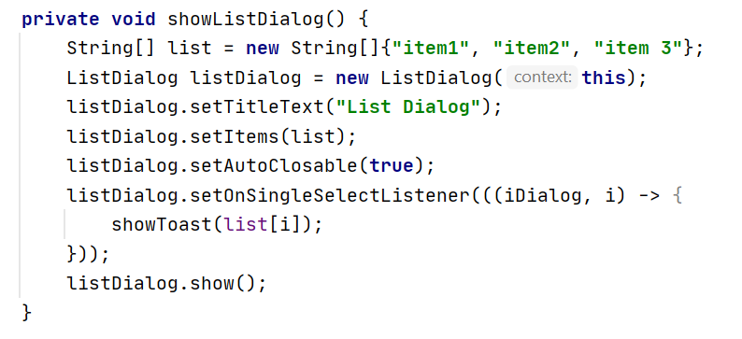
List Dialog
Creates a ListDialog instance
A list dialog box includes the radio box list and check box list.

Slide 6
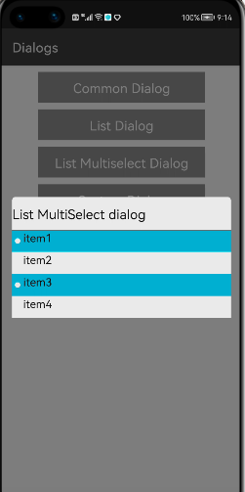
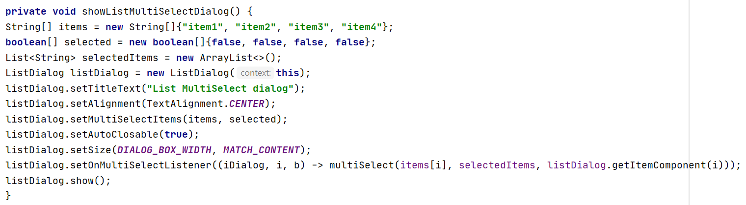
List Multiselect Dialog

Slide 7
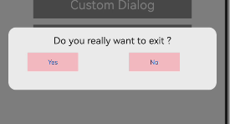
Custom Dialog creation
Create a custom class that extends CommonDialog.
Provide the component layout in xml file.
Use setContentCustomComponent and pass the component to it.

Slide 8
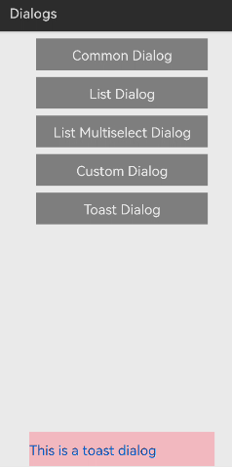
Toast Dialog
Provides a toast dialog box above a window to notify simple feedback for an operation.
Not clickable and disappears automatically

Slide 9
Notifications

Slide 10
NotificationRequest : carries notifications
NotificationRequest.NotificationNormalContent : basic notifications
NotificationRequest.NotificationPictureContent: notifications with a picture content
NotificationRequest.NotificationMultiLineContent :notifications with multiple lines of text
NotificationRequest.NotificationLongTextContent :Constructs notifications that include long text.
NotificationRequest.NotificationConversationalContent :Constructs a conversation-like notification that includes message communication among multiple users.
NotificationRequest.NotificationMediaContent : Constructs a media playback notification
Use setContent(ohos.event.notification.NotificationRequest.NotificationContent) method to specify the notification content

Slide 11
NotificationRequest.NotificationContent
Has constructors that takes arguments of type NotificationRequest.NotificationLongTextContent, NotificationRequest.NotificationPictureContent, NotificationRequest.NotificationNormalContent, NotificationRequest.NotificationMultiLineContent etc.
Once instance of the required type is created content type is also set to the appropriate value, which can be obtained using getContentType().

Slide 12
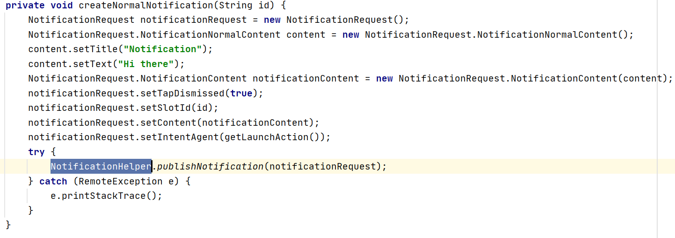
NotificationNormalContent : Creates basic notifications
NotificationHelper.publishNotification() : Publishes a notification

Slide 13
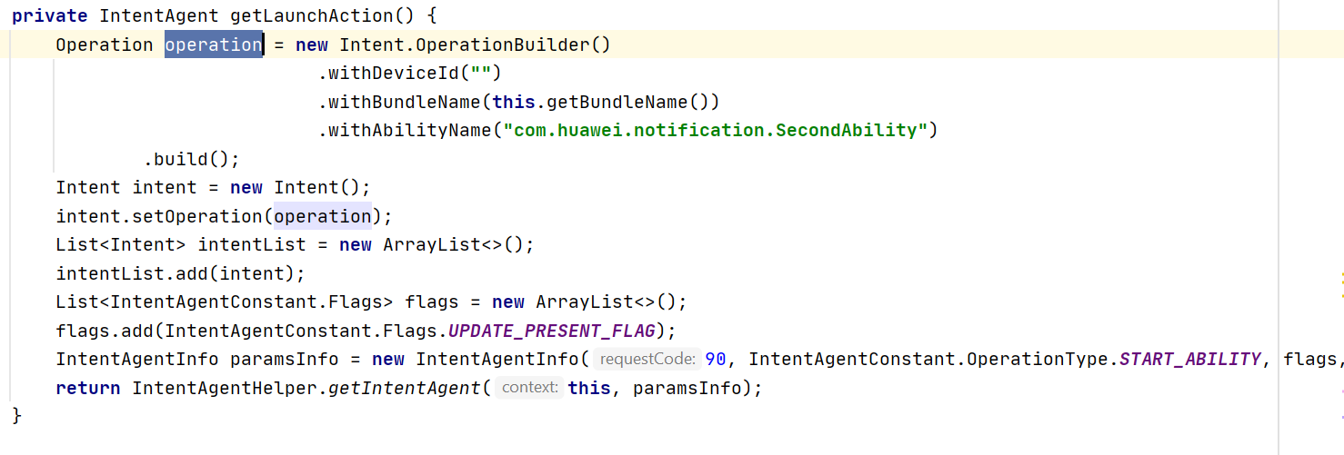
setIntentAgent(IntentAgent agent)
Adds an Intentagent to the notification
After a notification is tapped, subsequent operations such as ability and common events will be triggered as set by IntentAgent.

Slide 14
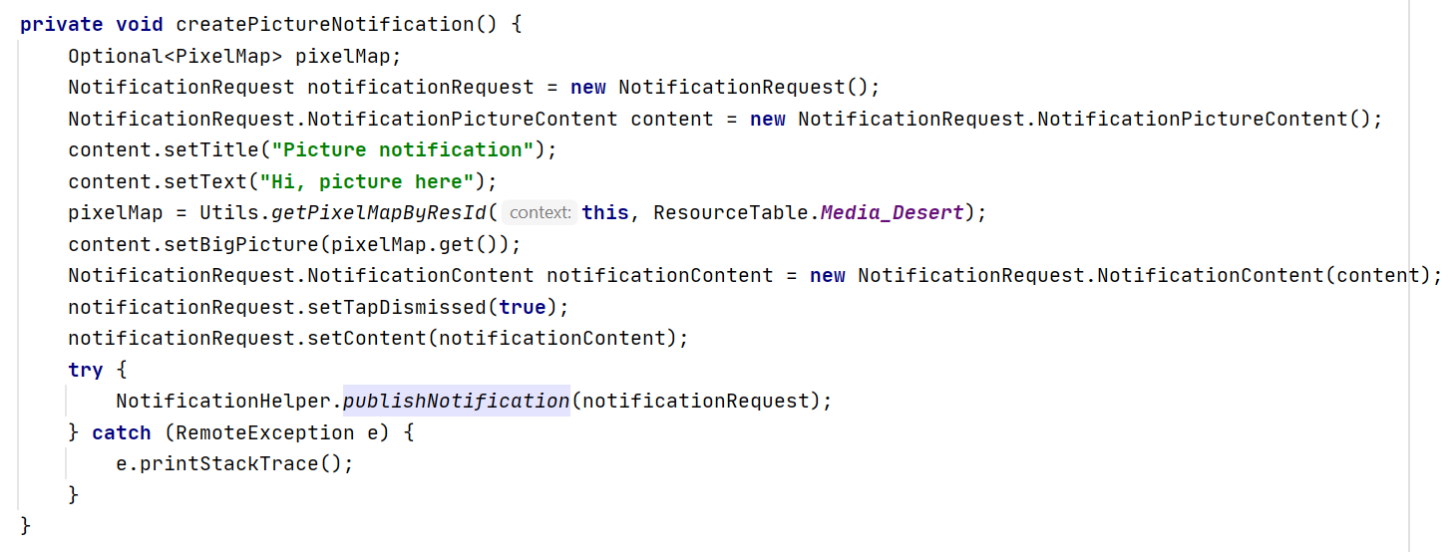
NotificationPictureContent : Creates notifications with picture attachment
setBigPicture : Sets the picture to be included in a notification.

Slide 15
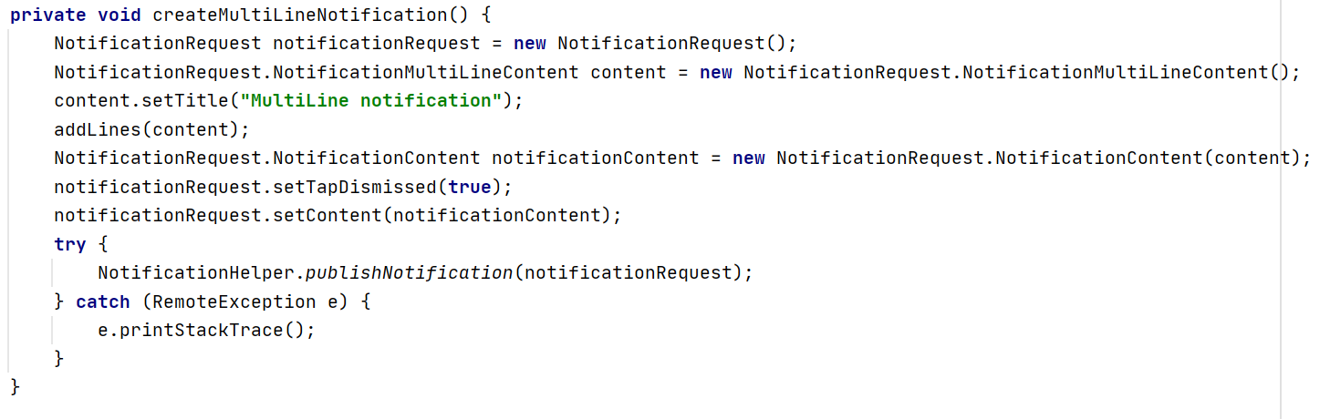
NotificationMultiLineContent : includes multiple lines of text

Slide 16
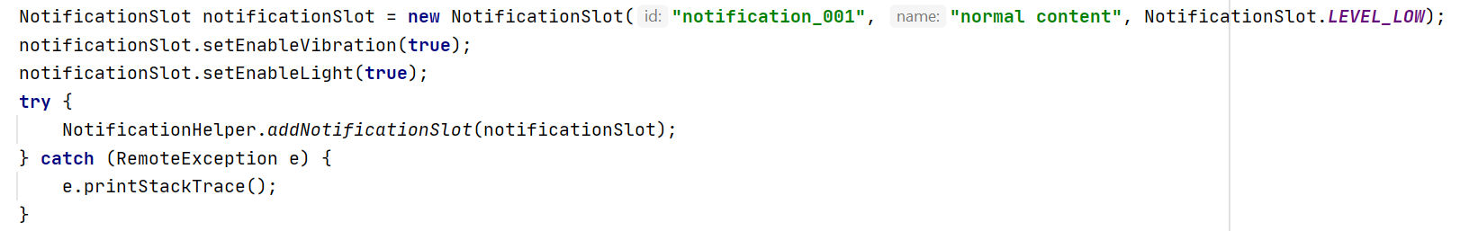
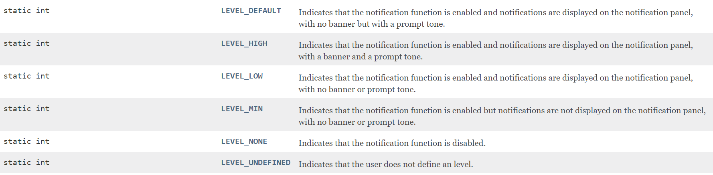
NotificationSlot
Defines a public notification theme, which is a collection of features including notification tone, vibration, lock screen display, and level.
setslotId : Sets the slot ID of a notification to bind the created NotificationSlot object.

Slide 17
THANK YOU

